Slide 1
Hyper-parallel Machine Learning and Big Data Mining Project
2019.5
Hongyi Guo

Slide 2
Contents
1
Introduction
2
Fully-Connected Network
3
Min-Max Modular Network
4
Inductive bias
5
CNN & Bi-RNN

Slide 3
Contents
1
Introduction
2
Fully-Connected Network
3
Min-Max Modular Network
4
Inductive bias
5
CNN & Bi-RNN

Slide 4
Introduction
This project aims to solve a 4-class classification problem. To be more specific, we tried to use EEG data to predict which emotion the subject is having.
The dataset is a subset of SEED-4 dataset, where the feature is differential entropy with 62 leads, and the feature dimension is 62 x 5 = 310. Labels are 0, 1, 2, 3, corresponding to four kinds of emotions: neutral, sad, fear and happy.
In the following parts, first, I am going to introduce some required baseline models and their experiments, including FC network, Min-Max Modular Network. Then I will introduce the Inductive Bias which is very important for my later model selection. Finally, I will show my CNN and RNN implementation and experiments.

Slide 5
Contents
1
Introduction
2
Fully-Connected Network
3
Min-Max Modular Network
4
Inductive bias
5
CNN & Bi-RNN

Slide 6
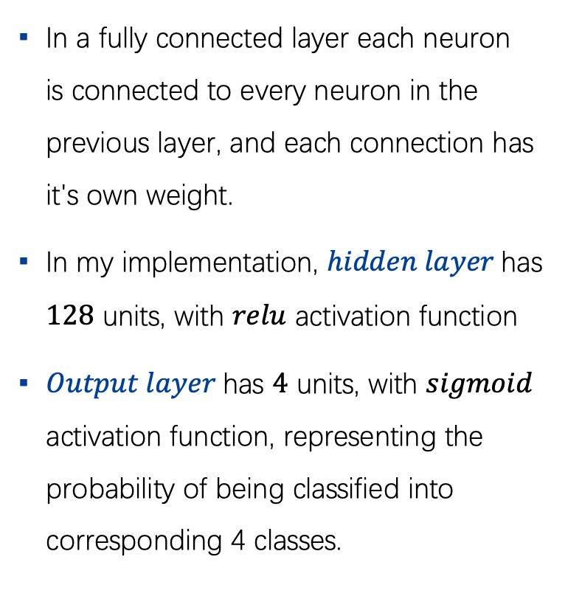
Fully-connected Network
In a fully connected layer each neuron is connected to every neuron in the previous layer, and each connection has it's own weight.
In my implementation, $hidden layer$has $128$ units, with $relu$ activation function
$Output layer$has $4$ units, with $sigmoid$ activation function, representing the probability of being classified into corresponding 4 classes.

Slide 7
Fully-connected Network

Slide 8
Contents
1
Introduction
2
Fully-Connected Network
3
Min-Max Modular Network
4
Inductive bias
5
CNN & Bi-RNN

Slide 9
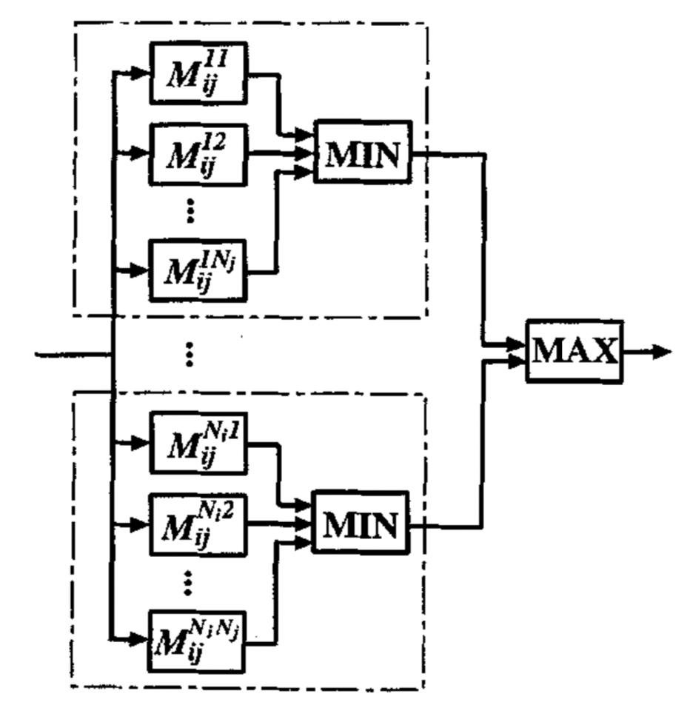
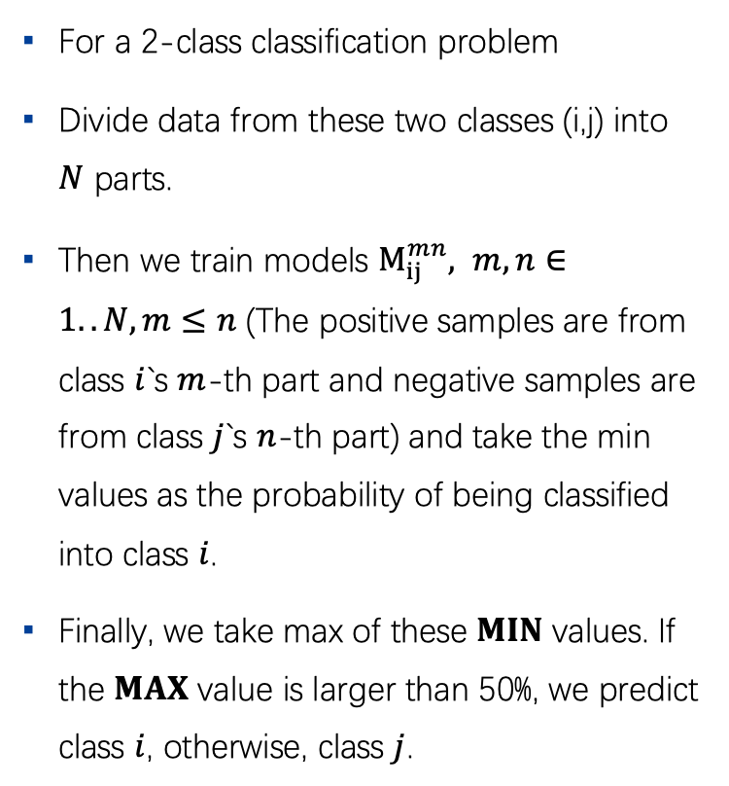
Min-Max Modular Network
For a 2-class classification problem
Divide data from these two classes (i,j) into $N$ parts.
Then we train models $M_{ij}^{mn}, m,n∈1..N, m≤n$ (The positive samples are from class $i$`s $m$-th part and negative samples are from class $j$`s $n$-th part) and take the min values as the probability of being classified into class $i$.
Finally, we take max of these $MIN$ values. If the $MAX$ value is larger than 50%, we predict class $i$, otherwise, class $j$.

Slide 10
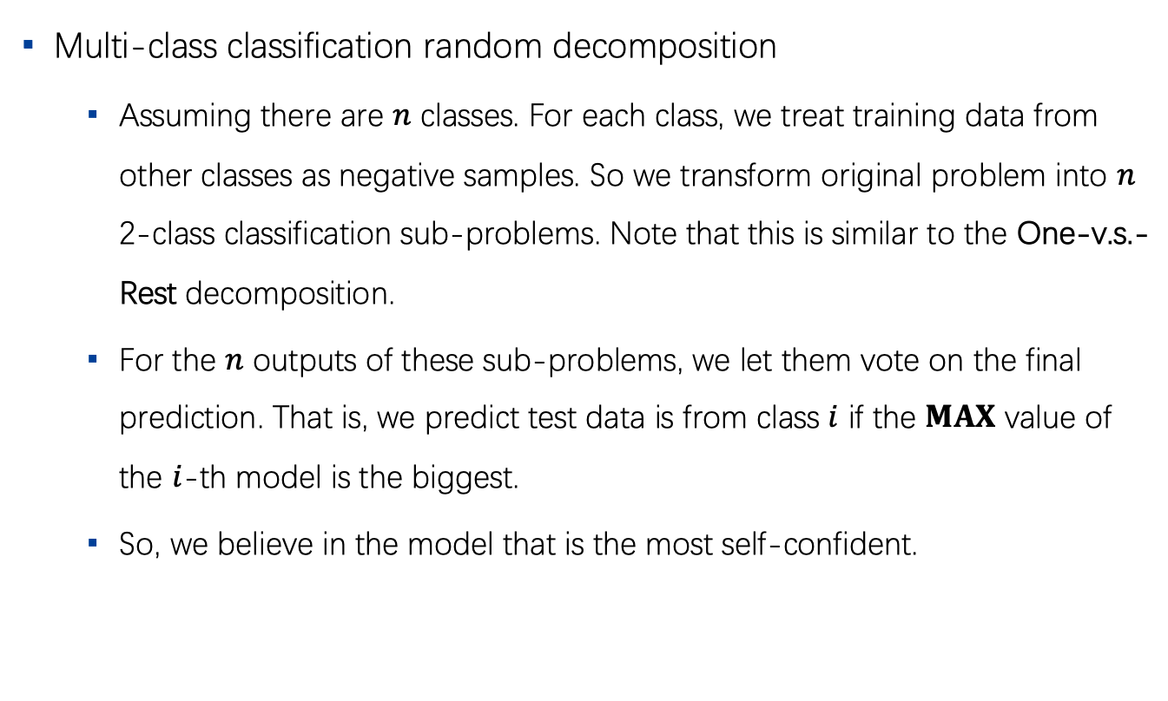
Min-Max Modular Network (1)
Multi-class classification random decomposition
Assuming there are $n$ classes. For each class, we treat training data from other classes as negative samples. So we transform original problem into $n$ 2-class classification sub-problems. Note that this is similar to the One-v.s.-Rest decomposition.
For the $n$ outputs of these sub-problems, we let them vote on the final prediction. That is, we predict test data is from class $i$ if the $MAX$ value of the $i$-th model is the biggest.
So, we believe in the model that is the most self-confident.

Slide 11
Min-Max Modular Network (1)

Slide 12
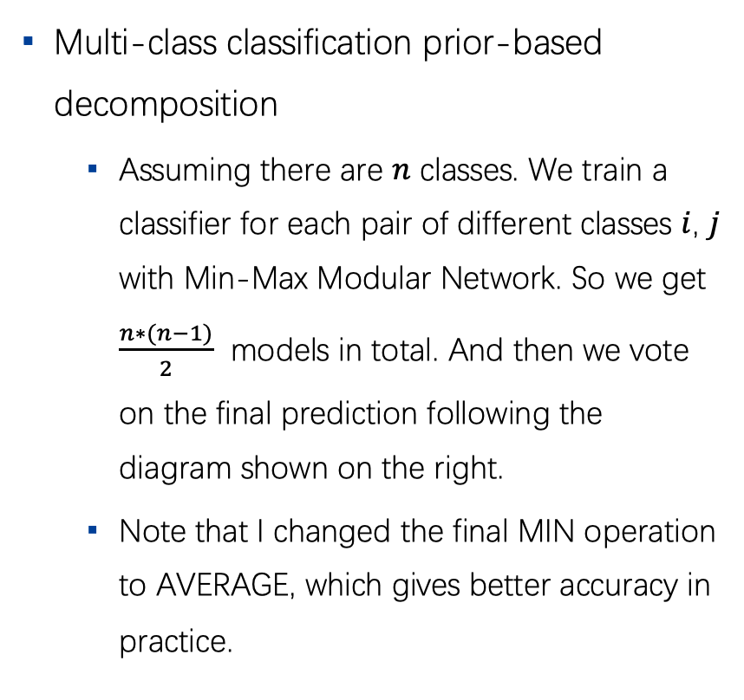
Min-Max Modular Network (2)
Multi-class classification prior-based decomposition
Assuming there are $n$ classes. We train a classifier for each pair of different classes $i$, $j$ with Min-Max Modular Network. So we get $\frac{n∗(n−1)}{2}$ models in total. And then we vote on the final prediction following the diagram shown on the right.
Note that I changed the final MIN operation to AVERAGE, which gives better accuracy in practice.

Slide 13
Min-Max Modular Network (2)

Slide 14
Contents
1
Introduction
2
Fully-Connected Network
3
Min-Max Modular Network
4
Inductive bias
5
CNN & Bi-RNN

Slide 15
Inductive Bias
Here I want to discuss the difference between nowadays deep neural networks and traditional shadow models from the perspective of the inductive bias.
The inductive bias (also known as learning bias) of a learning algorithm is the set of assumptions that the learner uses to predict outputs given inputs that it has not encountered.
The kind of necessary assumptions about the nature of the target function are subsumed in the phrase inductive bias.

Slide 16
Inductive Bias
Maximum margin:
When drawing a boundary between two classes, attempt to maximize the width of the boundary. This is the bias used in support vector machines. The assumption is that distinct classes tend to be separated by wide boundaries.
Nearest neighbors:
Assume that most of the cases in a small neighborhood in feature space belong to the same class. This is the bias used in the k-nearest neighbors algorithm. The assumption is that cases that are near each other tend to belong to the same class.
All to all:
For fully connected layers, the inductive bias assumes the relations are all-to-all (all units in layer i can affect all units in layer j). The implicit relational inductive bias in a fully connected layer is thus very weak: all input units can interact to determine any output units value, independently across outputs.

Slide 17
Inductive Bias
Convolutional layers in CNN
For convolutional layers in CNN, the inductive bias is locality and translation invariance.
Locality reflects that the arguments to the relational rule are those entities in close proximity with one another in the input signals coordinate space, isolated from distal entities. Translation invariance reflects reuse of the same rule across localities in the input.
Recurrent layers in RNN
We can view the inputs and hidden states at each processing step as the entities, and the Markov dependence of one steps hidden state on the previous hidden state and the current input, as the relations. The rule for combining the entities takes a steps inputs and hidden state as arguments to update the hidden state. The rule is reused over each step, which reflects the relational inductive bias of temporal invariance (similar to a CNNs translational invariance in space).
RNNs also carry a bias for locality in the sequence via their Markovian structure.

Slide 18
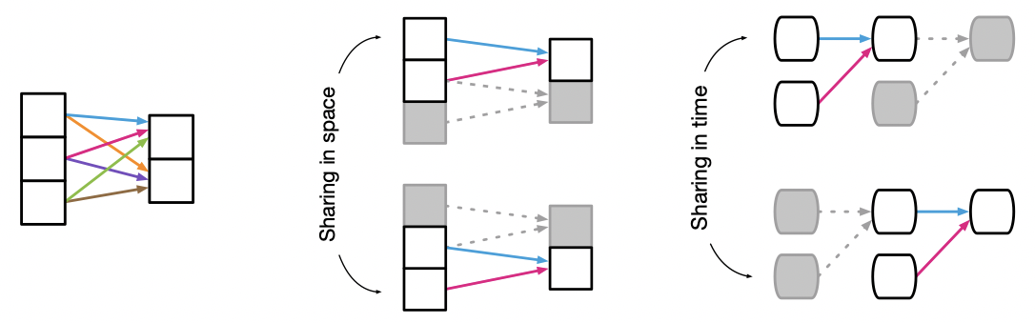
Inductive Bias
Compare the Inductive bias of FC, CNN, RNN

Slide 19
Contents
1
Introduction
2
Fully-Connected Network
3
Min-Max Modular Network
4
Inductive bias
5
CNN & Bi-RNN

Slide 20
Apply CNN
5
62
Implementation:
Conv1: kernel_size=(5,5), filters=16, stride=1, ac=relu
Conv2: kernel_size=(3,3), filters=32, stride=1, ac=relu
Fully-connected Layer: units=4, ac=sigmoid
Pool1: pool_size=(2,2), stride=2
Pool2: pool_size=(3,3), stride=2

Slide 21
CNN experiments

Slide 22
Apply RNN
Bi-LSTM
5
62
Implementation:
The latent size of the bidirectional LSTM cell is 32

Slide 23
RNN experiments

Slide 24
Time consumed

Slide 25
Thank you!

